Slide 1
Power BI Embedded Reports of My Death are Greatly Exaggerated

Slide 2
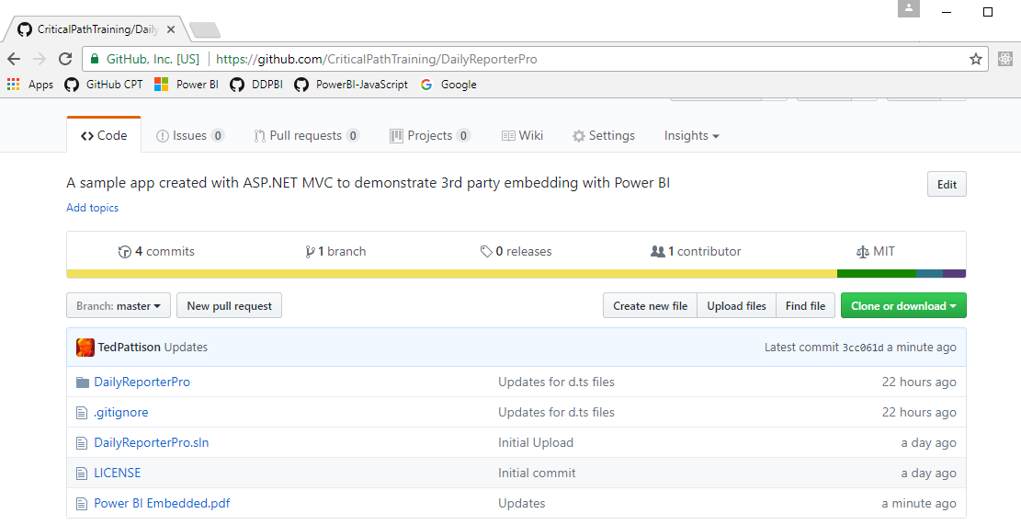
Code and Slides for this Session
https://github.com/CriticalPathTraining/PowerBiEmbedded

Slide 3
Agenda
Power BI Embedding Fundamentals
App Workspaces and Dedicated Capacities
Authentication with Azure Active Directory
Programming with Power BI Service API
Working with Embeddable Resources
Embedding with Power BI JavaScript API

Slide 4
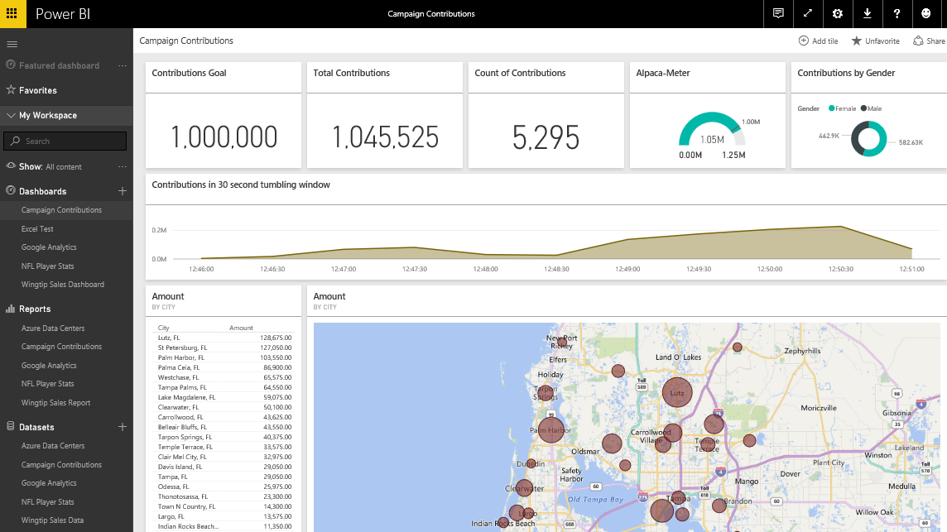
The Power BI Service
Provides cloud-based foundation for Power BI platform
Accessible with browser through https://app.powerbi.com
Accessible through Power BI mobile apps
Accessible to developers through Power BI Service API
Notes:
You can think of the Power BI service as the heart and sole of the Power BI platform. Subscribed users access the Power BI service using any modern browser through its primary URL which is https://app.powerbi.com. Once a user has been authenticated against the common endpoint of https://app.powerbi.com, the users is then connected to the Azure data center which hosts the user’s Power BI workspaces.
Using the browser, a Power BI subscriber can view dashboard and interactive reports. The browser-based experience of the Power BI service also provides support to import datasets and to create reports and dashboards.

Slide 5
The Power BI Service API
The Power BI Service API goes by other names
The Power BI REST API
The Power BI API
Using the Power BI Service API
Accessible by making direct REST calls against service
Accessible by using Assembly DLL that abstracts away REST calls
Assembly DLL is named Microsoft.PowerBI.Api.dll
Assembly DLL part of NuGet package (Microsoft.PowerBI.Api)
Calling service requires authentication with Azure Active Directory
Your App
Power BI Service

Slide 6
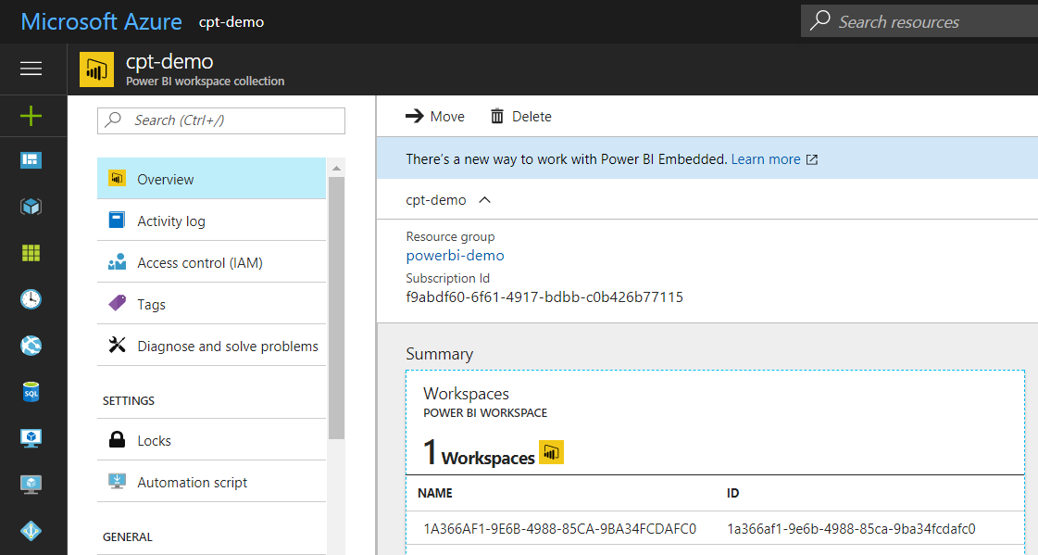
What is was Power BI Embedded V1?
Power BI Embedded V1 is an Azure Service
PBI Embedded service that was provisioned on-demand
Service provisioned in terms of workspace collections
Pricing model based on number of report sessions
Power BI Embedded was Sunset-ed Beginning in May 2017

Slide 7
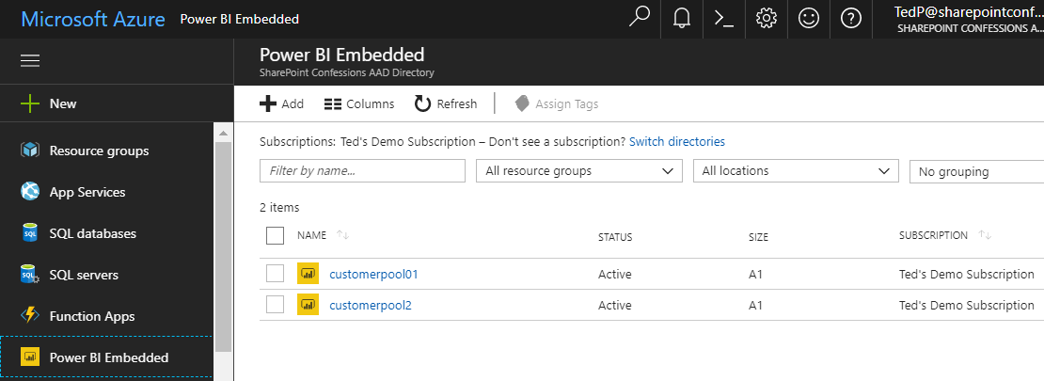
Power BI Embedded Version 2
Power BI Embedded V2 has same good points as V1
It eliminates need for Power BI license for each user
It opens up PBI platform to commercial applications
Power BI Embedded V2 significantly improves upon V1
Created as on-demand service using Azure subscription
Service can be scaled up, scaled down or stopped
Embedding features available through Power BI Service API
Standard PBI UX used to upload and manage PBIX files

Slide 8
Power BI Embedding – The Big Picture
User launches your app using a browser
App authenticates with Azure Active Directory and obtains access token
App uses access token to call to Power BI Service API
App retrieves data for embedded resource and passes it to browser.
Client-side code uses Power BI JavaScript API to create embedded resource
Embedded resource session created between browser and Power BI service
5
Power BI Service
User
iFrame
6
4
4
3
1
Your App
2
Azure AD

Slide 9
First Party Embedding
App authenticates current user with Azure AD
Your code accesses Power BI Service as current user
Embedding requires Azure AD access token for user
User requires Azure AD account and Power BI license
Your code has access to whatever user has access to
Embed URL for Power BI resource
Access Token for current user
User
Power BI Service
iFrame

Slide 10
Third Party Embedding
App authenticates using Master User Account
Your code accesses Power BI Service as master user
Embedding uses embed token instead of access token
Users don’t need AAD accounts and Power BI licenses
Your code has access to whatever master has access to
Embed URL for Power BI resource
Embed Token created with master user account
User
Power BI Service
iFrame

Slide 11
First Party vs Third Party Embedding
What scenarios use first party embedding?
Organizations where users have Power BI licenses
Embedding Power BI reports in SharePoint and Teams
Development should go beyond out-of-box experience
What scenarios use third party embedding?
Scenarios where users don’t have Power BI licenses
Applications which have custom identity providers
Applications which use identity provider other than AAD

Slide 12
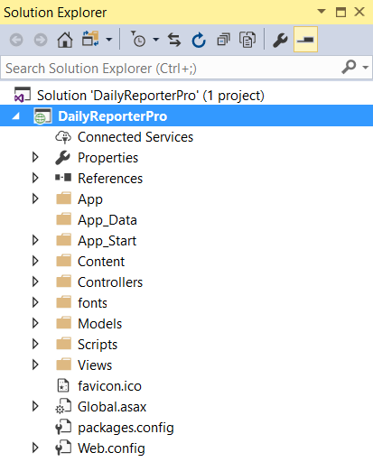
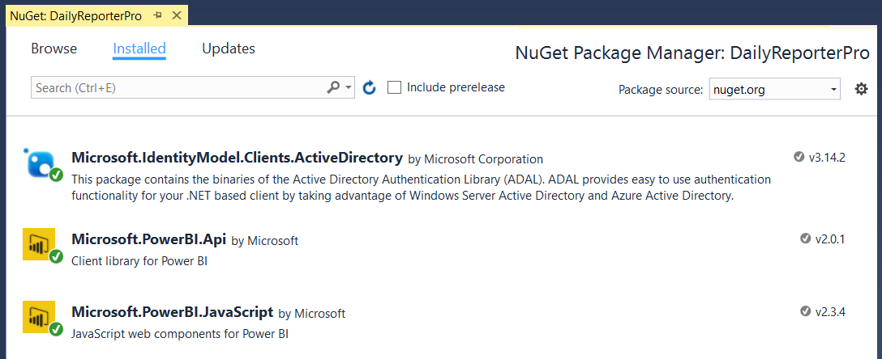
NuGet Packages Required in MVC Project
NuGet Packages used in DailyReporterPro sample app
Azure Active Directory Library (ADAL) for .NET
Power BI Service API
Power BI JavaScript API

Slide 13
The Daily Reporter Pro Sample App

Slide 14
Agenda
Power BI Embedding Fundamentals
App Workspaces and Dedicated Capacities
Authentication with Azure Active Directory
Programming with Power BI Service API
Working with Embeddable Resources
Embedding with Power BI JavaScript API

Slide 15
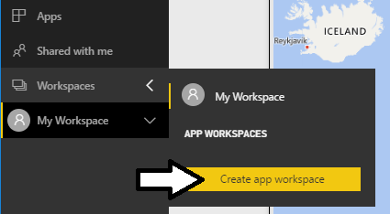
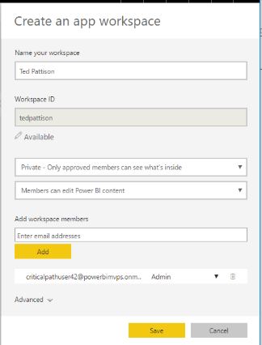
Understanding App Workspaces
App workspaces used to deploy custom solutions
App workspaces required for team-based development
App workspace can be secured using private membership
App workspace used to publish apps for licensed users
App workspaces required for 3rd party embedding
App workspace must be added to premium capacity
Master user account must be configured as app workspace admin

Slide 16
Dedicated Capacities
Power BI workspaces run in two possible environments
Shared Capacities
Dedicated Capacities
Power BI Premium Capacities
Power BI Embedded Capacities
Dedicated capacity acts as dedicated resource
Dedicated capacity only used by single organization
PBIX file uploads not limited to 1GB
Data refresh frequency can exceed 8 times per day
Each dedicated capacity defines its own set of admins

Slide 17
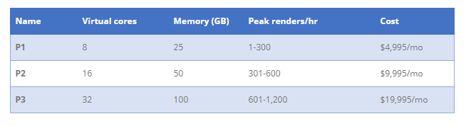
P SKUs (P is for Premium)
All-in version which allows greatest flexibility
Used to provide free users with access to apps
Used to provide free users with access to shared dashboards
Supports 1st party and 3rd party embedding
It's also by far the most expensive starting point

Slide 18
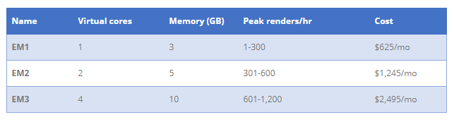
EM SKUs (EM is for Embedded)
SKUs for embedding into SaaS Applications
SaaS applications include SharePoint and Teams
Supports 1st party and 3rd party embedding
Does not provide user with access to PowerBI.com

Slide 19
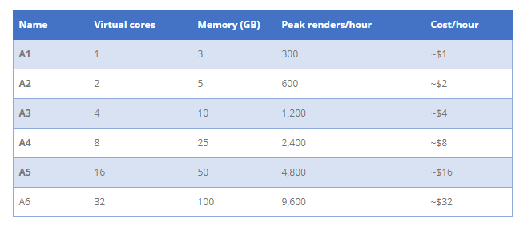
A SKUs (A is for Azure)
A SKU is a Platform-as-a-Service
Used by ISVs as the data visualization layer
Allows for PBI Embedding into Custom Applications
Only supports 3rd party embedding (i.e. App-Owns-Data model)

Slide 20
PBI Capacity SKU Decoder Ring
 | P SKUs | EM SKU | A SKUs
Purchase | Office | Office | Azure
Embed content in custom application | Yes | Yes | Yes
Share content with free PBI users outside PowerBI.com | Yes | Yes | No
Share content with free PBI users inside PowerBI.com | Yes | No | No
Billing | Monthly | Monthly | Hourly
Commitment | Monthly/Yearly | Yearly | None
Turn it off when your not using it | No | No | Yes

Slide 21
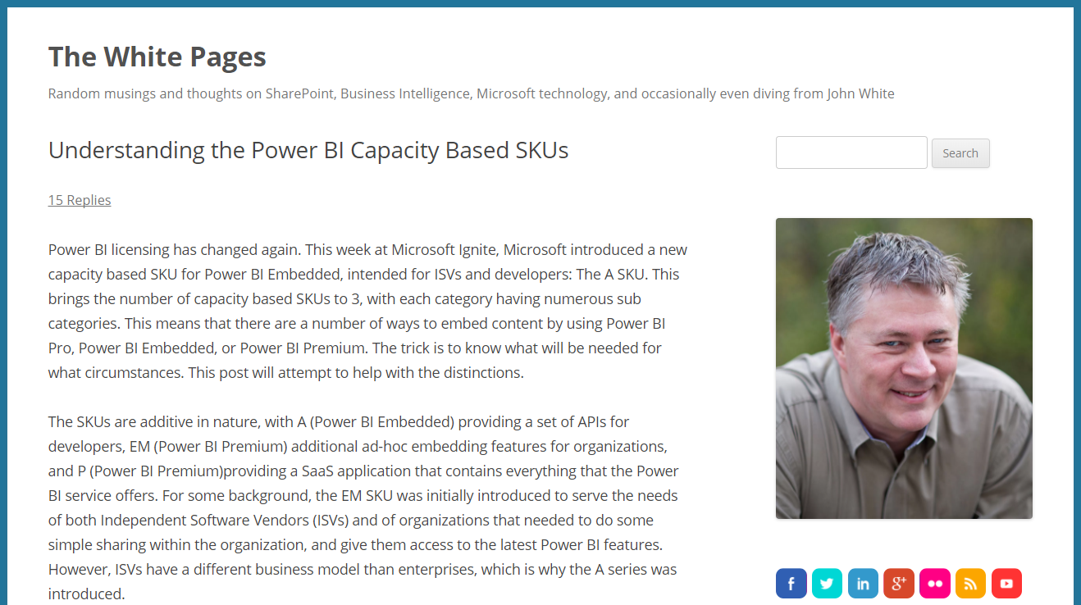
Great Blog Explanation by John White
https://whitepages.unlimitedviz.com/2017/09/understanding-the-power-bi-capacity-based-skus/

Slide 22
Agenda
Power BI Embedding Fundamentals
App Workspaces and Dedicated Capacities
Authentication with Azure Active Directory
Programming with Power BI Service API
Working with Embeddable Resources
Embedding with Power BI JavaScript API

Slide 23
Tenants and Organizational Accounts
Azure AD used to authenticate users and apps
PBI licenses are assigned to Azure AD user accounts
Organization owns a tenant (i.e. directory)
AAD tenant contains user accounts and groups
AAD tenant contains set of registered applications
You must register your application with Azure AD
Requirement of calling to Power BI service API
Applications registered as Web app or Native app
Registered applications are assigned GUID for client ID
Application is configured with permissions

Slide 24
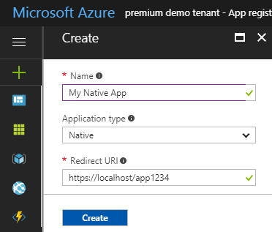
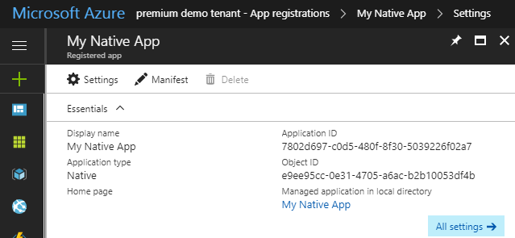
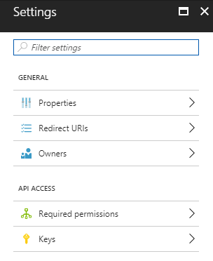
Creating an Azure AD Application

Slide 25
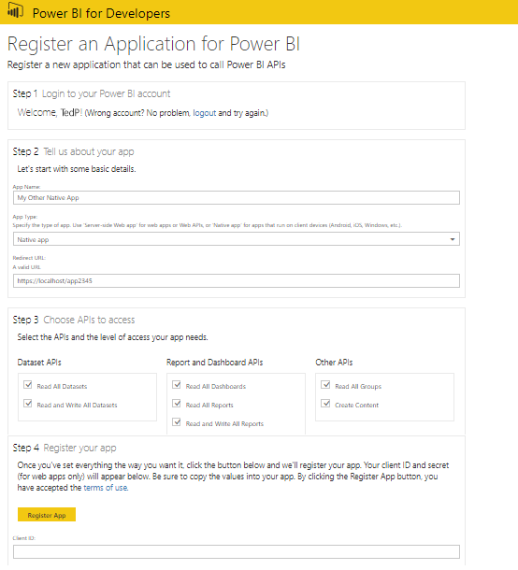
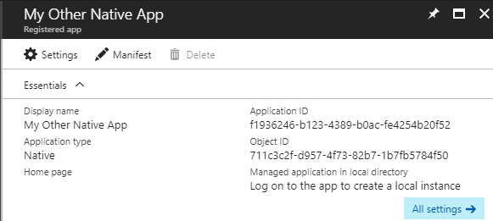
Power BI App Registration Page
https://app.powerbi.com/apps

Slide 26
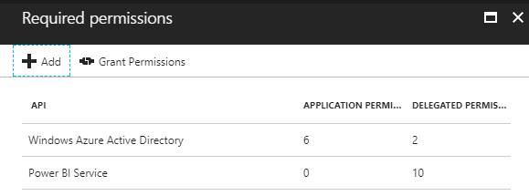
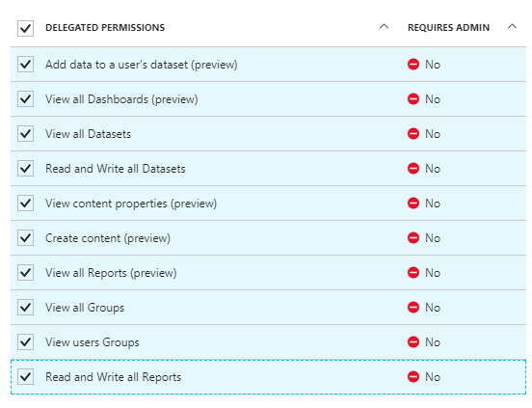
Application Permissions
Applications can be granted permissions to other applications
Application permissions are app-only permissions
Delegated permissions are (app + user) permissions
Delegated permissions requires 1-time consent from user

Slide 27
Authentication Flows
Client Credentials Grant Flow (confidential client)
Authentication based on SSL certificate with public-private key pair
Used to obtain access token when using app-only permissions
Authorization Code Grant Flow (confidential client)
Client first obtains authorization code then access token
Server-side application code never sees user’s password
Implicit Grant Flow (public client)
Used in SPAs built with JavaScript and AngularJS
Application obtains access token w/o acquiring authorization code
User Credentials Flow (public client)
Used in Native clients to obtain access code
Requires passing user name and password

Slide 28
1st Party Embedding vs 3rd Party Embedding
 | 1st Part Embedding | 3rd Party Embedding
Authentication flow | Authentication Code Grant Flow or Implicit Flow | Direct User Credentials
Identity used to call Power BI | Current User | Master User Account
Access to personal workspace | Yes | No
Access to app workspaces | Yes | Yes
Ability to reach non-licensed users | No | Yes
Supported Power BI Capacity SKUs | P* and EM* SKUs | P*, EM* and A* SKUs

Slide 29
Registering an App with Azure AD

Slide 30
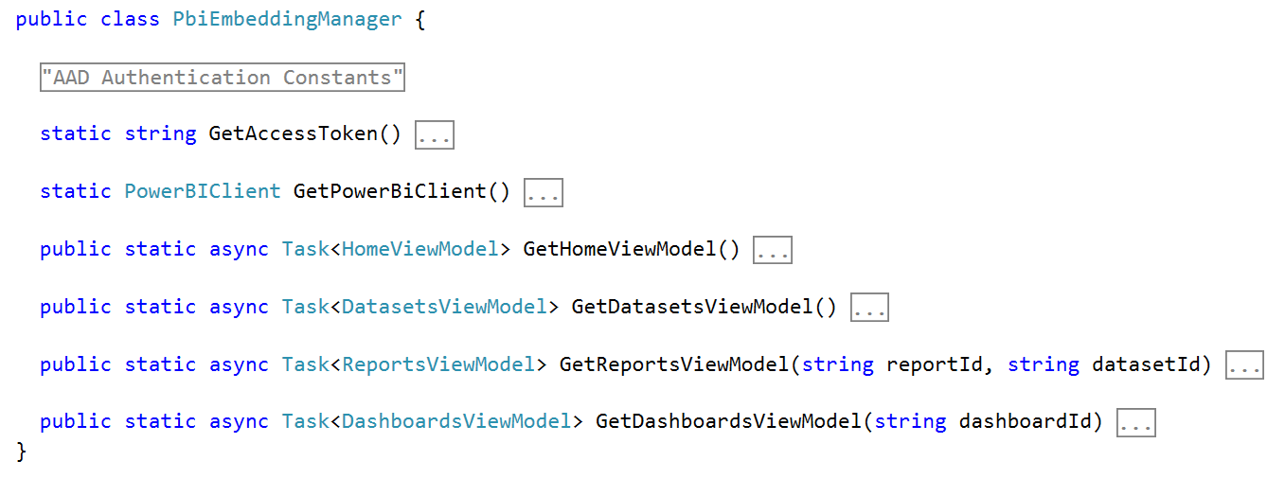
PbiEmbeddingManger Class
PbiEmbeddingManger Class responsibilities
Get access tokens from Azure AD
Retrieve embedding data from Power BI service
Pass embedding data to browser using MVC view models

Slide 31
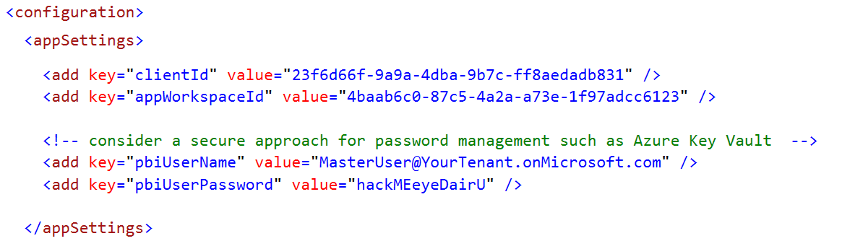
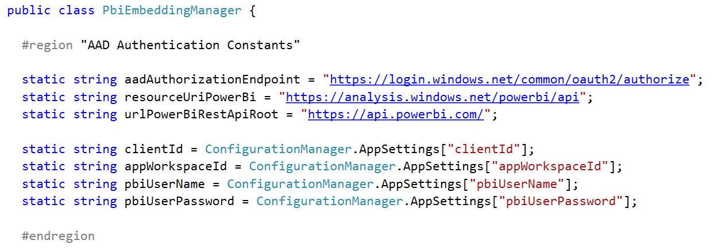
Data Required for AAD Authentication

Slide 32
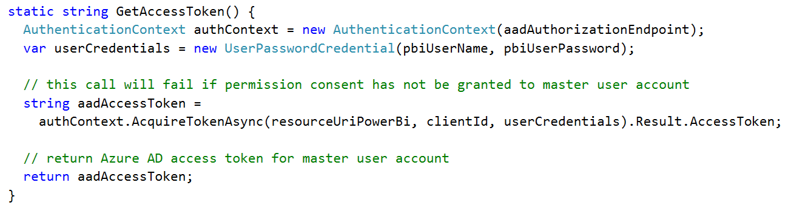
Getting an Access Token for the Master User

Slide 33
Agenda
Power BI Embedding Fundamentals
App Workspaces and Dedicated Capacities
Authentication with Azure Active Directory
Programming with Power BI Service API
Working with Embeddable Resources
Embedding with Power BI JavaScript API

Slide 34
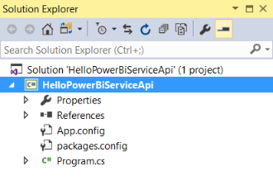
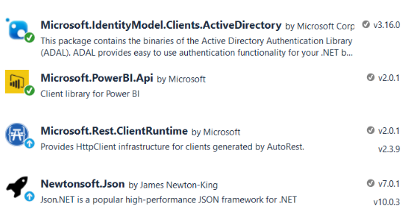
HelloPowerBiServiceApi Demo
Let’s get started with a simple C# console app
NuGet packages added for ADAL and Power BI Service API

Slide 35
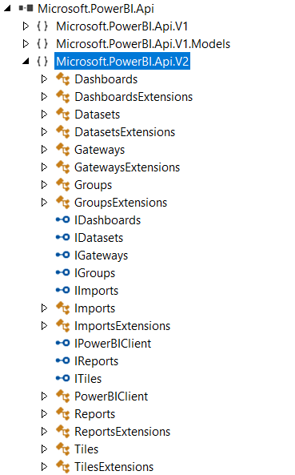
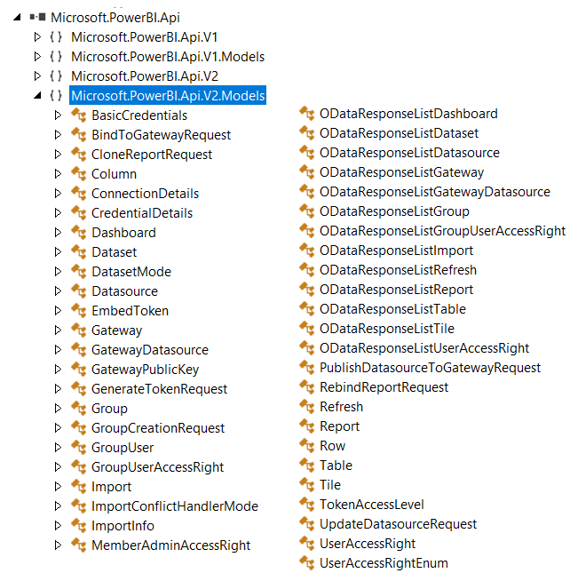
The Power BI Service API

Slide 36
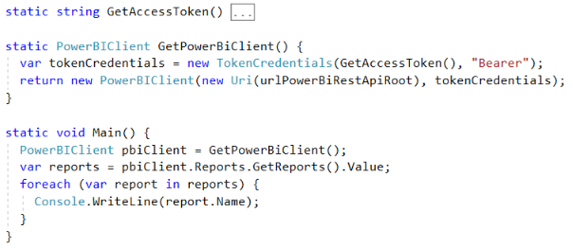
Initializing a Instance of PowerBIClient
PowerBIClient object serves as top-level object
Used to execute calls against Power BI Service
Initialized with function to retrieve AAD access token

Slide 37
Programming the Power BI Service API

Slide 38
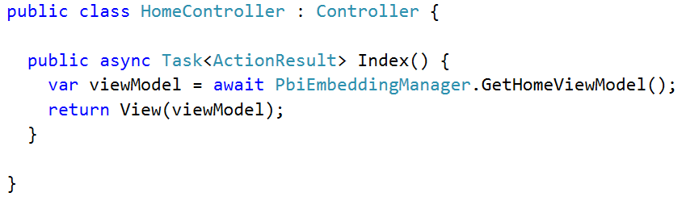
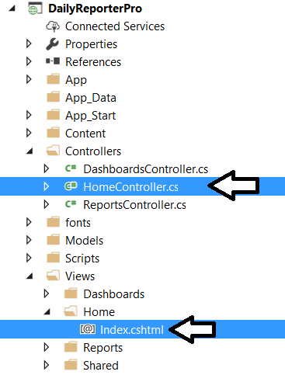
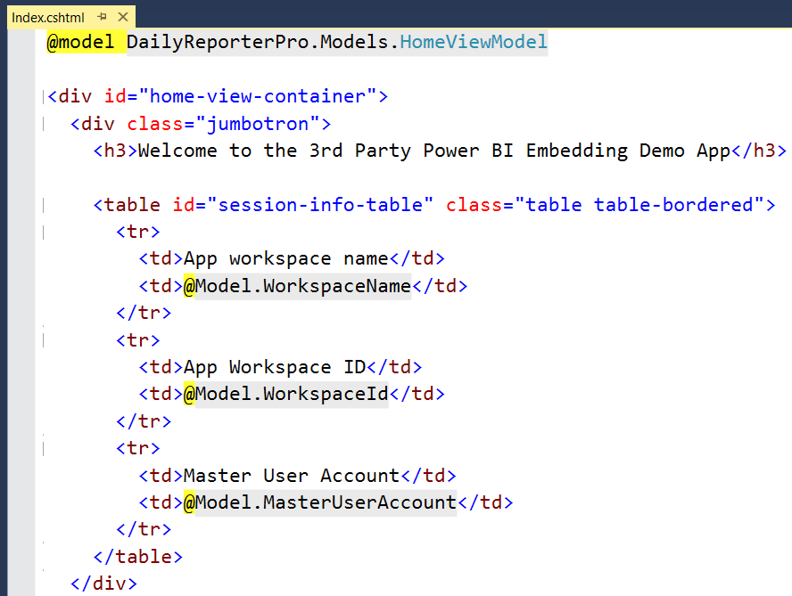
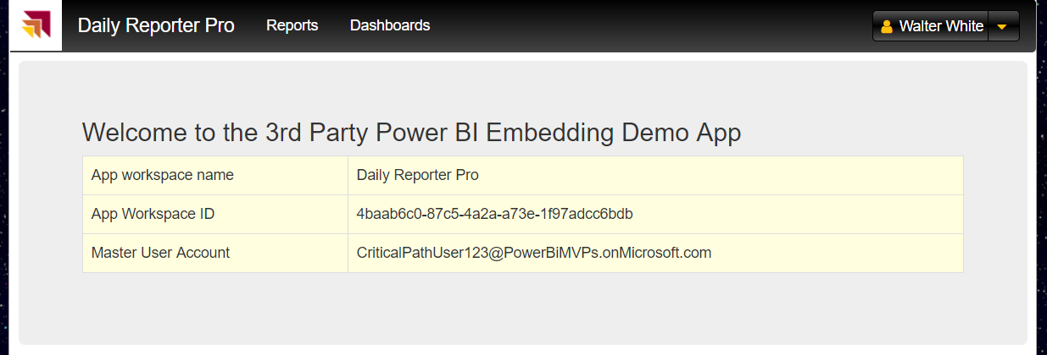
MVC Controllers and Views

Slide 39
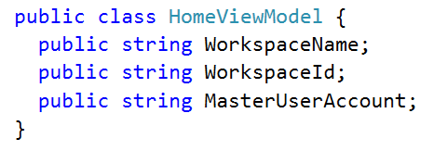
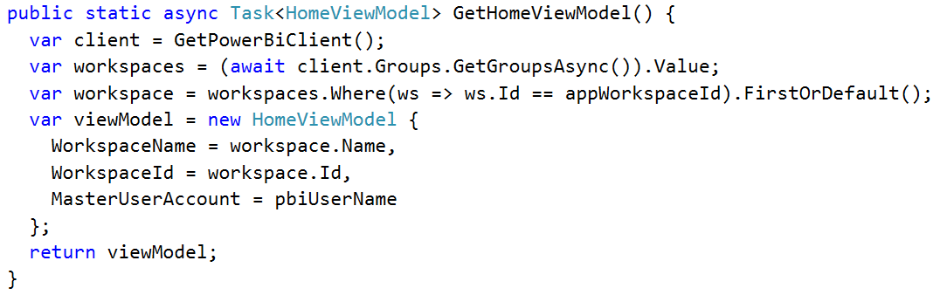
Back to the DailyReporterPro Application
Your App
Power BI Service

Slide 40
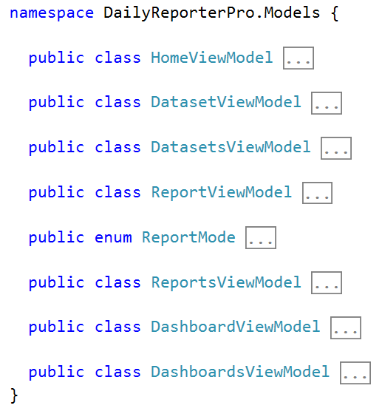
MVC View Models

Slide 41
Agenda
Power BI Embedding Fundamentals
App Workspaces and Dedicated Capacities
Authentication with Azure Active Directory
Programming with Power BI Service API
Working with Embeddable Resources
Embedding with Power BI JavaScript API

Slide 42
Embeddable Resources
Reports
Provides user with full interactive experience
Allows editing existing reports & creating new reports
Dashboards
Provides user with limited interactive experience
Provides support for real-time dashboards
Dashboard Tiles
Provides flexibility to embed selected tiles
No support for tiles which receive real-time updates

Slide 43
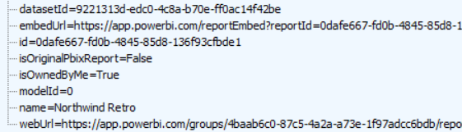

Report and Dataset Info
Embed data required for an existing report
Embed data for dataset required to create new report

Slide 44
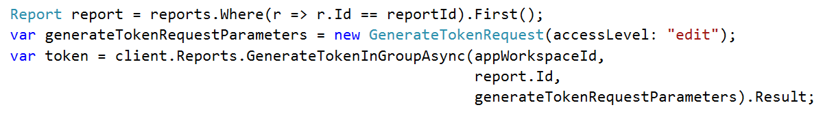
Embed Tokens
You can embed reports using master user AAD token, but…
You might want embed resource using more restricted tokens
You might want stay within the bounds of Power BI licensing terms
Power BI service supports generating embed tokens
Embed token provides restrictions on whether user can view or edit
Each embed token created for one specific resource
Embed token can only be generated inside Power BI Premium capacity
Supports generating tokens using row-level security (RLS)

Slide 45
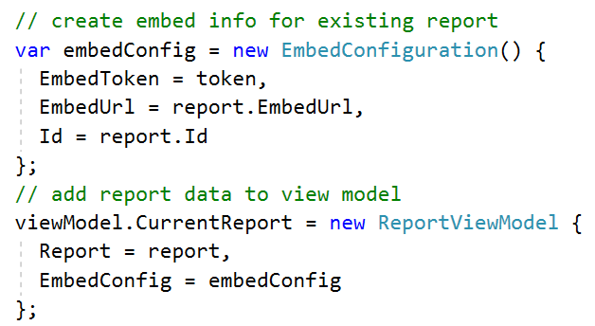
View Model with Embed Data for Report

Slide 46
Agenda
Power BI Embedding Fundamentals
App Workspaces and Dedicated Capacities
Authentication with Azure Active Directory
Programming with Power BI Service API
Working with Embeddable Resources
Embedding with Power BI JavaScript API

Slide 47
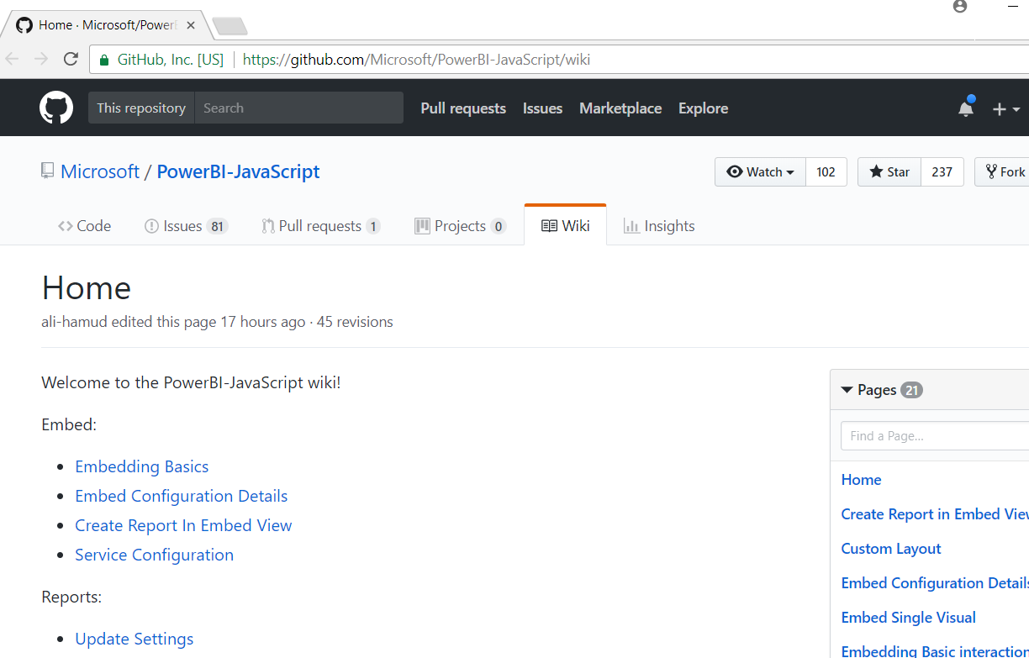
Power BI JavaScript API Wiki
https://github.com/Microsoft/PowerBI-JavaScript/wiki

Slide 48
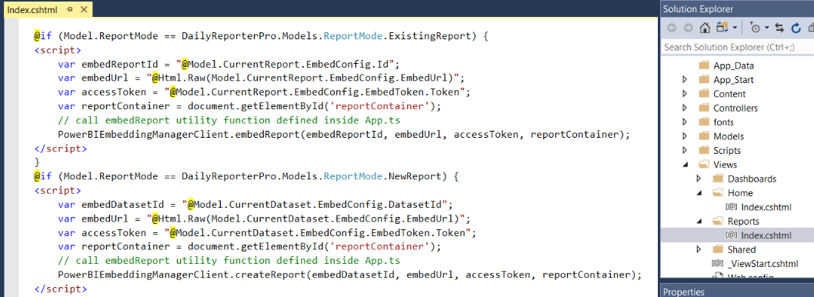
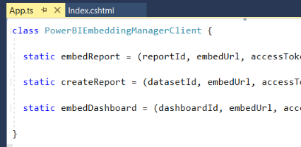
Embedding Data in MVC View

Slide 49
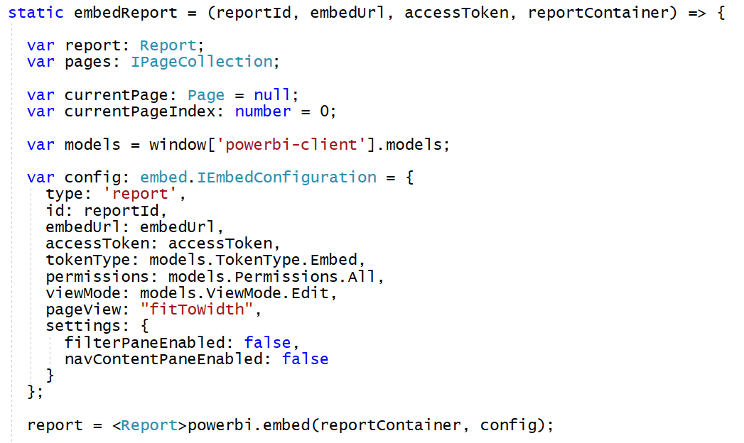
Loading an Embedded Report

Slide 50
Embedded Report Options
Read: Allows view report only.
ReadWrite: Allows view, Edit and Save report.
Copy: Allows Save a copy of a report using Save As.
Create: Allows creating a new report.
All: Allows everything.
View - Opens report in View mode.
Edit - Opens report in Edit mode.
fitToWidth: Fit to width of host HTML element.
oneColumn: Opens in single column.
actualSize: Actual size as designed in report

Slide 51
Programming the Power BI JavaScript API

Slide 52
Summary
Power BI Embedding Fundamentals
App Workspaces and Dedicated Capacities
Authentication with Azure Active Directory
Programming with Power BI Service API
Working with Embeddable Resources
Embedding with Power BI JavaScript API

Slide 53

Critical Path Training https://www.CriticalPathTrainig.com
PBI365: Power BI Boot Camp – 4 Days
Audience is Business Users, Analysts and Data Professionals
Provides hands-on introduction to the Power BI platform
Focuses on build solutions using Power BI Desktop
Query design, data modeling and report and dashboard design
Apps and App Workspaces
Learn about “import” vs “connect to” with Excel workbooks
PBD365: Power BI Developer Boot Camp – 4 Days
Audience is Professional Developers
Teaches developing custom visuals with TypeScript and D3
Teaches R programming and integrating R with Power BI
Teaches programming with the Power BI APIs
Teaches developing with Power BI Embedded

